Slide 1



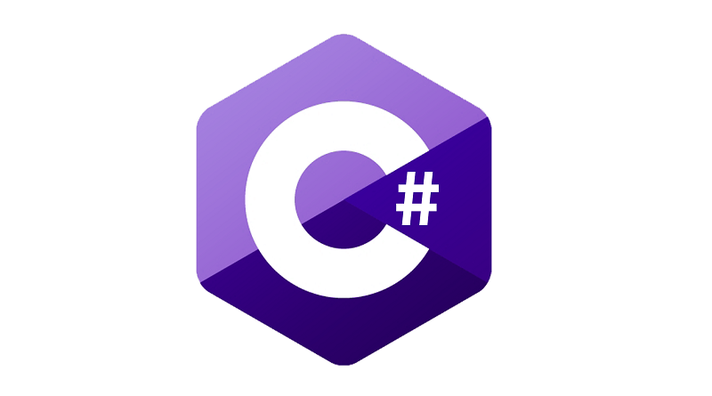

POC
Presented by :
Lasya Nallamalli
Chandrika Munaganuri

Slide 2
PROJECT AGENDA
Read a file from Azure Storage account
If file is valid, move file to Valid folder, else to Invalid folder
Insert the data of the valid files in Azure Cosmos DB (MongoDB)
Create a Cron job and deploy in Azure Kubernetes service.
Send an acknowledgement email

Slide 3
TECH STACK
C# .net
Azure Storage account
Azure Cosmos DB (MongoDB)
Azure Function App
Azure Logic app
AKS

Slide 4
MODULES
File Accessing and Validation
Insert data into DB
Send an acknowledgement email
Docker image creation and publishing
Deploy a Cron Job in AKS Cluster

Slide 5
File Accessing and Validation
The file has to be accessed from the Azure Storage account and validated according to the constraints:-
Valid - .csv and .xlsx file formats
Invalid - other file formats
A storage account inside a resource group has to be created which has storage types like Containers, File shares, Queues, Tables.

Slide 6
File Accessing and Validation
Details
A blob container is created in a storage account of Azure DCE.
This container consists of directories:-
Input-folder - where user uploads the files
Output-folder - has Valid directory with all valid files, and Invalid directory with all invalid files.

Slide 7
File Accessing and Validation
Details
The container is accessed using connection string of storage account.
For this, we need to install the NuGet package, 'Azure.Storage.Blobs'.
The c# .net code creates a 'BlobServiceClient' object using the provided connnection string and then, it gets a reference to the blob container and the specific blob.

Slide 8
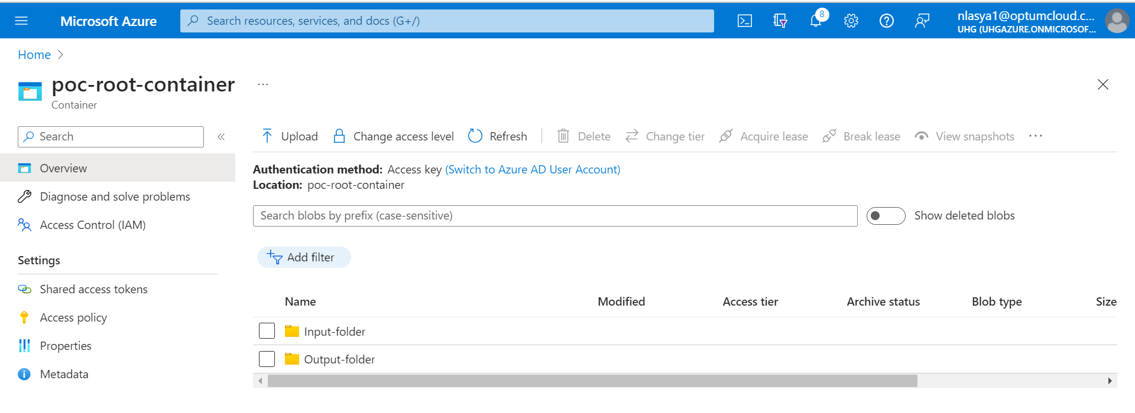
File Accessing and Validation

Slide 9
Insert data into DB
The data of the valid files are stored in Azure cosmos MongoDB.
MongoDB stores data objects in collections and documents instead of the tables and rows used in traditional relational databases.
Documents consist of key-value pairs which are basic unit of data in MongoDB.

Slide 10
Insert data into DB
We describe the schema of the MongoDB data model in a Function app.
Then this is published into the Azure Function App from which we get the Function Url.
This Function Url and content (i.e; data of valid files) is passed in the httpclient.PostAsync() method in c# .net application.
After calling the PostAsync() method with the content as parameter, the content which is sent is formatted into the MongoDB data model format, this formatted data gets inserted into the Azure Cosmos Mongo DB.

Slide 11
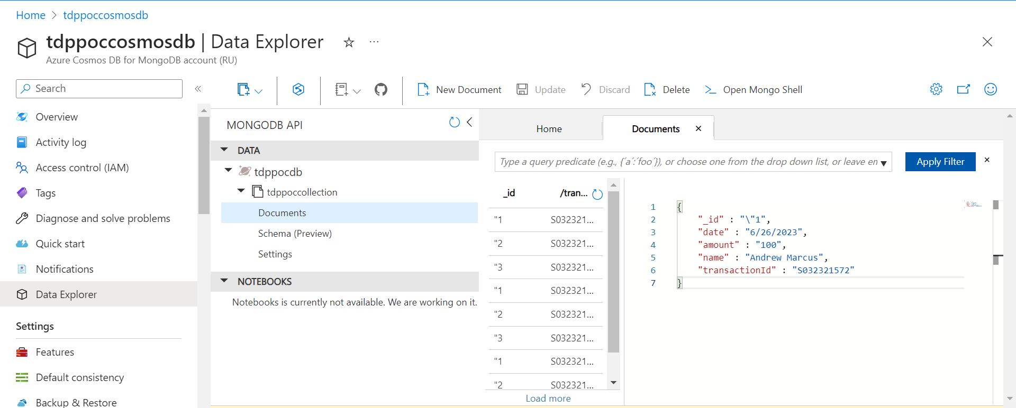
Insert data into DB

Slide 12
Send an Acknowledge mail
An acknowledgement mail is sent to the user prompting the number of valid and invalid files in Input-folder of the Blob container.
Suppose there are no files to validate then the mail prompts the user to upload files

Slide 13
Send an Acknowledge mail
Azure Logic App
Azure Logic app enables us to build automated workflows and integrate various applications, data sources and services.
Inside this logic app, we can customize the actions in the required format.
For sending mail, we need 2 actions.
1. When a http request is received
2. Send an email

Slide 14
Send an Acknowledge mail
1. When a HTTP request is recieved
The HTTP request consists of a request body that takes input (such as email_body) and maps to the JSON schema.
We can also define the method like GET, POST, PUT to trigger the HTTP request.

Slide 15
Send an Acknowledge mail
2. Send an email
The sender email has to be authenticated.
Then, the parameters such as email body to need to be configured.
These parameters can be set either as static values or dynamic content from the previous steps in the workflow.

Slide 16
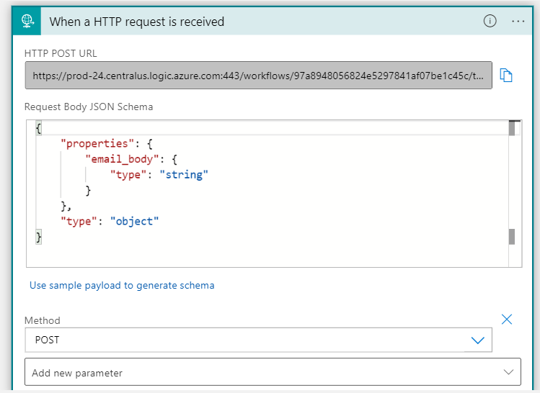
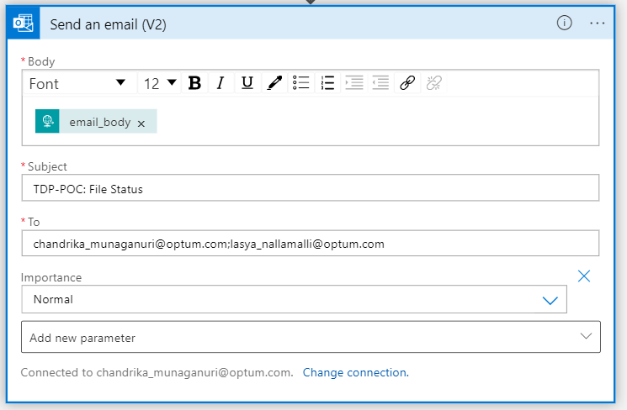
Send an Acknowledge mail

Slide 17
Send an Acknowledge mail
HTTP request using POST method
To trigger the HTTP request, we can use the 'HttpClient class' which is available in 'System.Net.Http' namespace.
This class allows us to send HTTP request and receive responses from a specified URI.
By using the PostAsync(apiUrl, requestBody), we trigger the HTTP request.

Slide 18
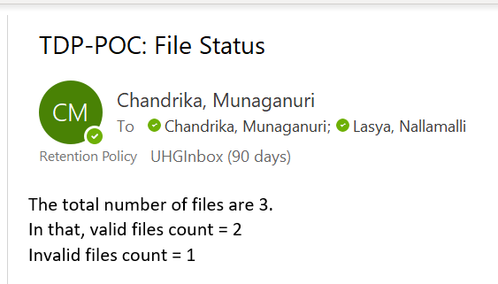
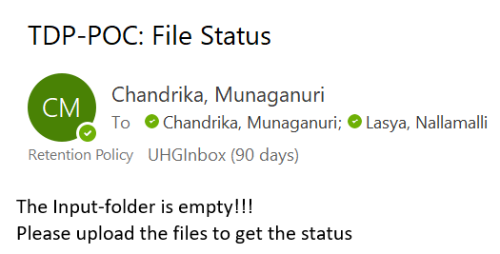
Send an Acknowledge mail

Slide 19
Docker Image
Creation and Publishing
To deploy a cron job in AKS we need a docker image.
For creating the docker image, docker support has to be added in the application which includes Dockerfile and .dockerignore files.
The application has to be further published into Azure Container Registry.
where the application gets build, docker image is created and gets pushed into the container registry.

Slide 20
Deploy a Cron job in AKS Cluster
A job in AKS creates and manages the pods that run a specific task and it terminates once the it is completed.
The cron job is a Kubernetes resource used to schedule and run jobs at specified time intervals based on a "cron-like schedule".
Based on the cron schedule, a pod gets created by the job which pulls the docker image from the repository of the container registry.

Slide 21
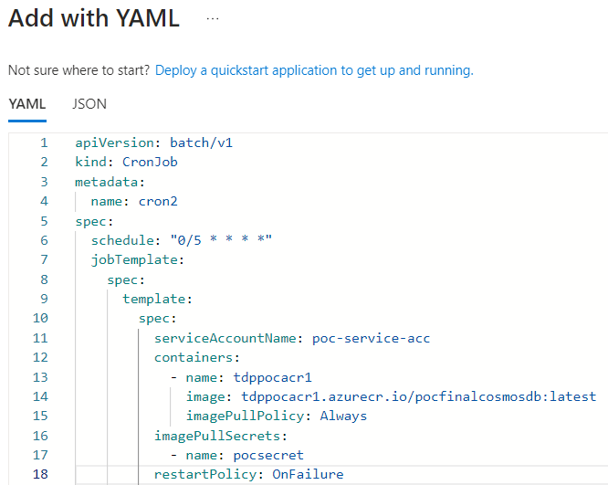
Deploy a Cron job in AKS Cluster
YAML file

Slide 22
Deploy a Cron job in AKS Cluster
YAML file
apiVersion - Kubernetes API version
kind - Type of resource being defined
metadata - contains metadata information about cron job
name - name of the cron job
spec - defines the specifications of the cron job
schedule - specifies the cron schedule when the job should run
"* * * * *" - 'minute hour day-of-month month day-of-week'
"0/5 * * * *" - specifies for every 5 minutes

Slide 23
Deploy a Cron job in AKS Cluster
YAML file
jobTemplate - defines the template for the job created by the cron job
template - specifies the template for the pods created by job
serviceAccountName - name of service account
that we want to use for the pod created by the cron job
containers - defines the containers that will run inside the pod
name - container name
image - docker image to be used by the container

Slide 24
Deploy a Cron job in AKS Cluster
YAML file
imagePullPolicy: Always - ensures that Kubernetes always attempts to pull the latest version of the container image
imagePullSecrets - stores authentication credentials used to pull container images from private
name - secret name
restartPolicy : OnFailure - The pod will be restarted if it fails

Slide 25
Deploy a Cron job in AKS Cluster
Secret : It can be associated with pods or other resources to enable secure communication between containers or to authenticate with external systems.
Service Account : The pods created by the job will use the service account's (which is specified in the cron job YAML file) permissions to access resources within the Kubernetes cluster.
Namespace: It is a way to organize resources within cluster.
The secret or service account created in a namespace, is usable within that namespace.

Slide 26
DEMO

Slide 27
Queries ?

Slide 28
Thank you

